Slide 1
Carpooling for the Green Initiative
Chase Cupp, Chris Hewitt, Doug Murphy, Emanuel Smith
6/26/14

Slide 2
Table of Content
Problem Statement
Requirements
Assumptions and Constraints
App Design
UML
Flowchart
Pseudo code
Testing
Future Work

Slide 3
App Design
Overview, Login, Create New Account, Home Page, Search Menu, Create Pickup group, Notifications

Slide 4
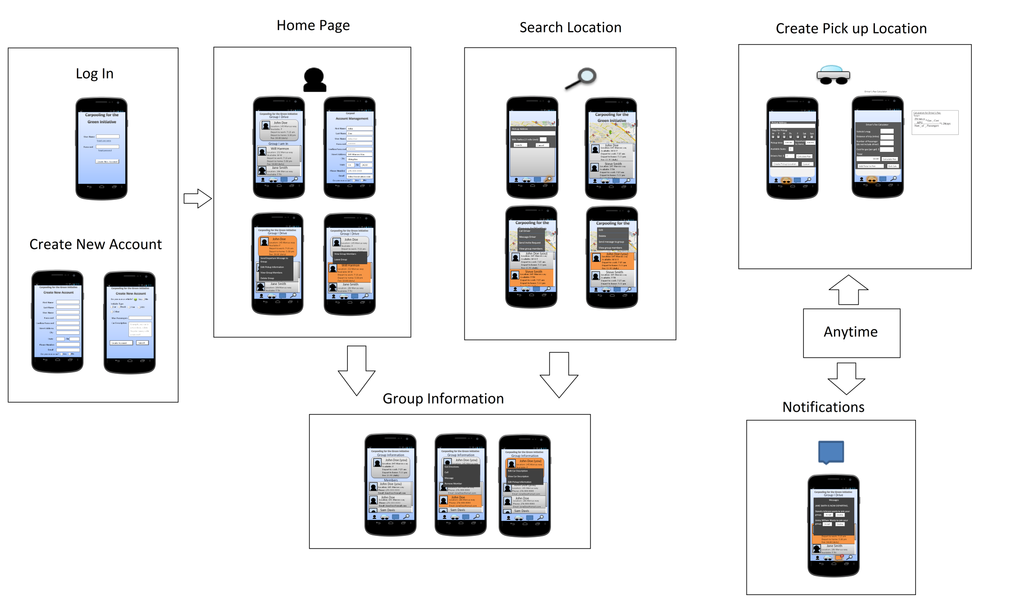
Overview

Slide 5
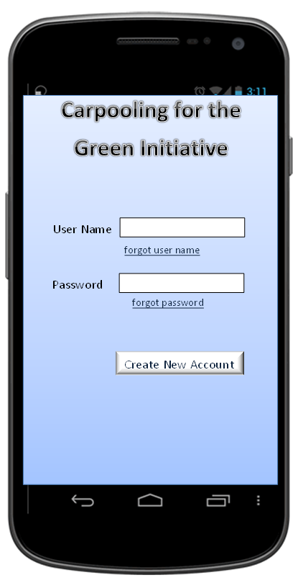
Login

Slide 6
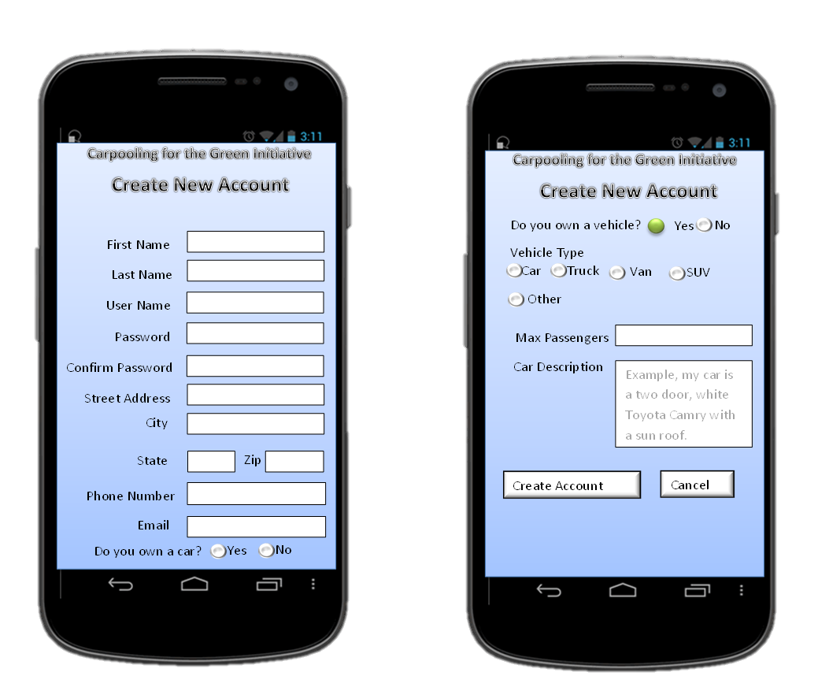
Create New Account

Slide 7

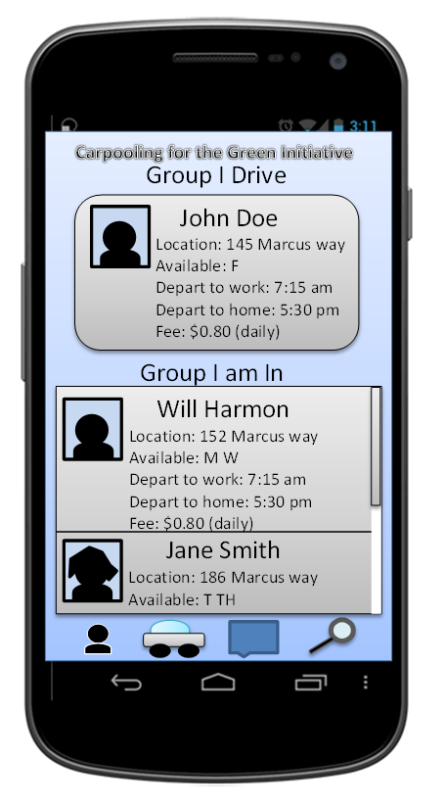
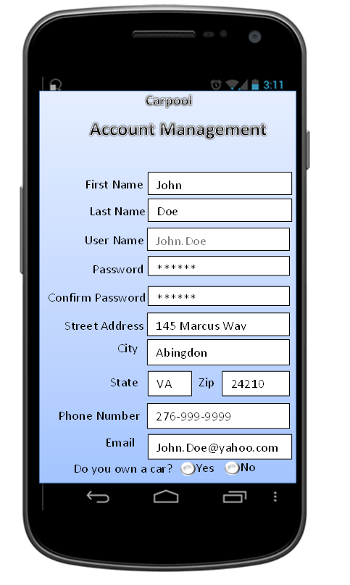
Home Page

Slide 8
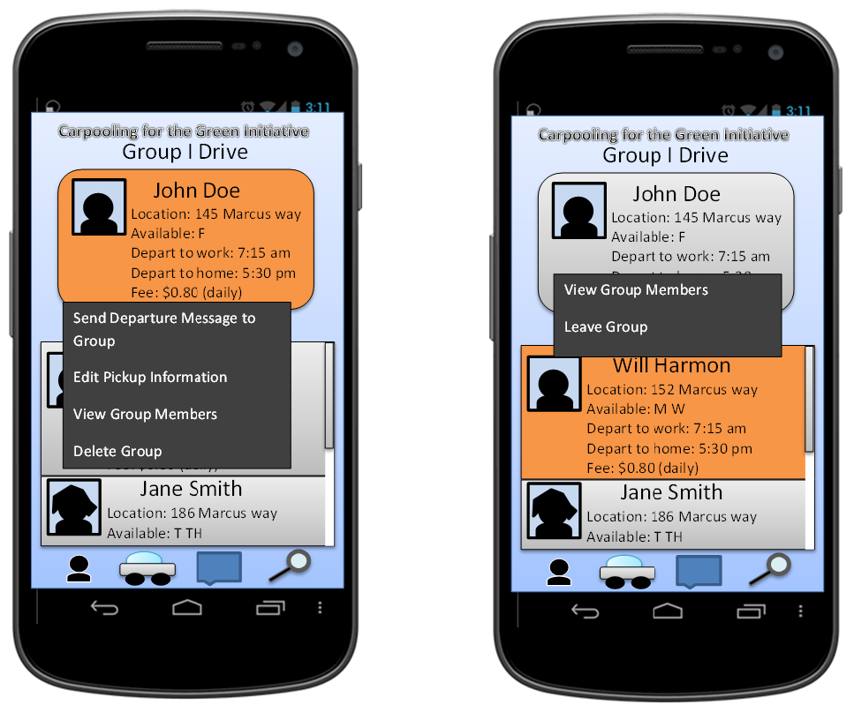
Home Page Continued

Slide 9

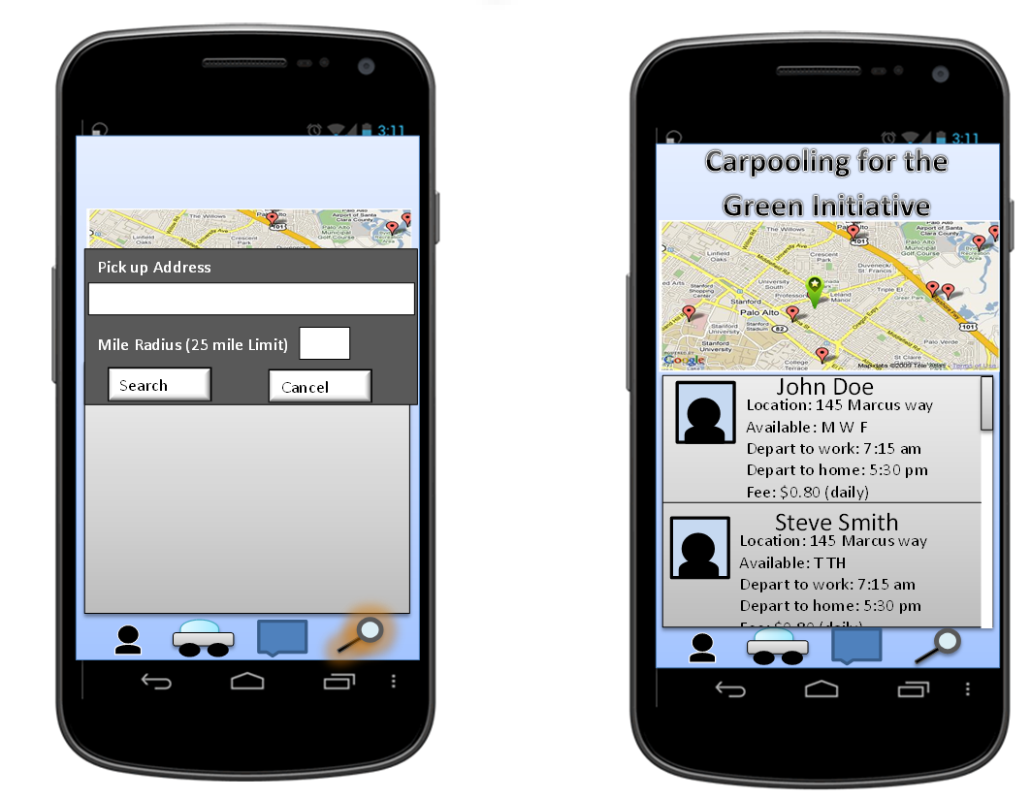
Search Menu

Slide 10
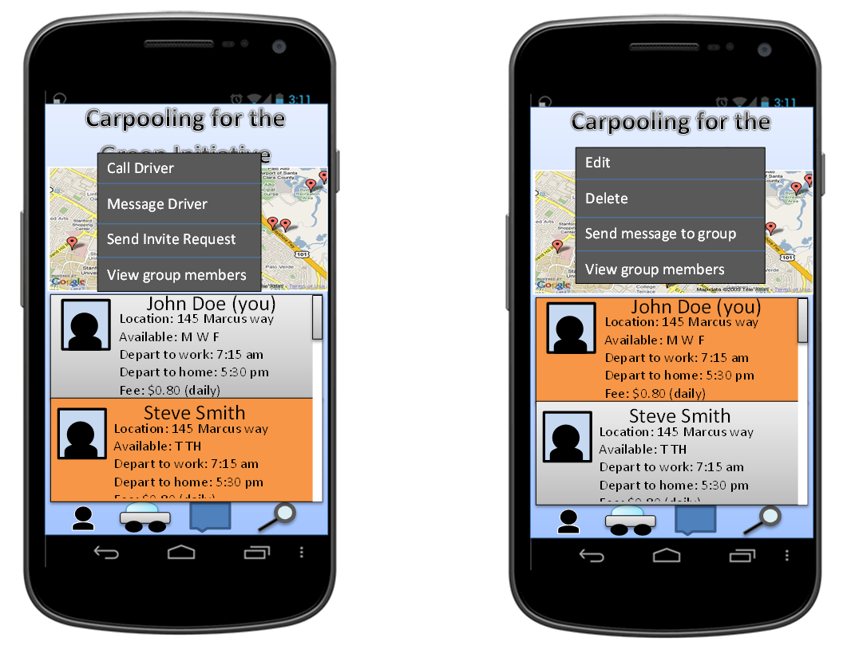
Search Menu Continued

Slide 11

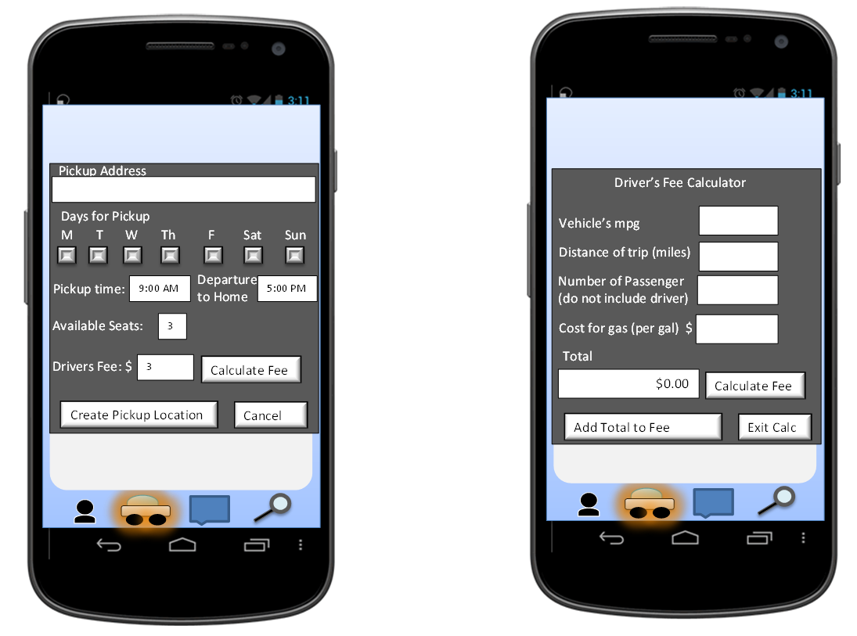
Create Pickup Group

Slide 12

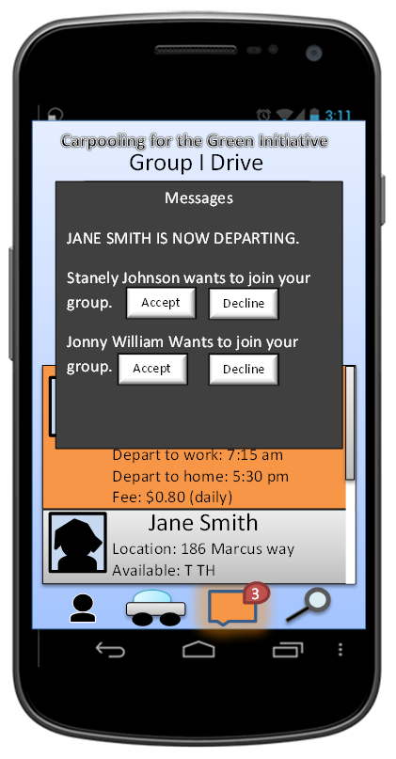
Notifications

Slide 13
UML Diagram

Slide 14
Flowchart

Slide 15
Pseudo code

Slide 16
Future Work

Slide 17
Questions?

